Slide 1
RUSTikales Rust for advanced coders

Slide 2
Plan for today
Recap
Weak<T>
Declarative Macros

Slide 3
Recap

Slide 4
Recap
Ownership and Borrow Checker are very powerful
Guarantee memory safety at compile time

Slide 5
Recap
Ownership and Borrow Checker are very powerful
Guarantee memory safety at compile time
However, guarantees come with a price → If only one program is invalid and still compiles successfully, everything falls apart → Compiler must be strict and reject potentially valid code sometimes

Slide 6
Recap
Ownership and Borrow Checker are very powerful
Guarantee memory safety at compile time
However, guarantees come with a price → Compiler must be strict and reject potentially valid code sometimes
If we know our code is valid, and it won‘t compile, we can use Smart Pointers to fix that
Instead of performing all checks at compile time, we do them at runtime
Our duty to make sure everything is correct, else our program panics at runtime

Slide 7
Recap
Ownership and Borrow Checker are very powerful
Guarantee memory safety at compile time
However, guarantees come with a price → Compiler must be strict and reject potentially valid code sometimes
If we know our code is valid, and it won‘t compile, we can use Smart Pointers to fix that
Rc<T> allows Shared Ownership
The underlying data T is reference counted and can be shared between many owners

Slide 8
Recap
Ownership and Borrow Checker are very powerful
Guarantee memory safety at compile time
However, guarantees come with a price → Compiler must be strict and reject potentially valid code sometimes
If we know our code is valid, and it won‘t compile, we can use Smart Pointers to fix that
Rc<T> allows Shared Ownership
RefCell<T> uses Interior Mutability to check borrows at runtime
Using .[try_]borrow() and .[try_]borrow_mut() we can simulate &T and &mut T respectively

Slide 9
Recap
Ownership and Borrow Checker are very powerful
Guarantee memory safety at compile time
However, guarantees come with a price → Compiler must be strict and reject potentially valid code sometimes
If we know our code is valid, and it won‘t compile, we can use Smart Pointers to fix that
Rc<T> allows Shared Ownership
RefCell<T> uses Interior Mutability to check borrows at runtime
Using .[try_]borrow() and .[try_]borrow_mut() we can simulate &T and &mut T respectively
Interior Mutability
We only use &RefCell<T> in our whole codebase to pass the Borrow Checker at compile time
Internally, we can still modify the underlying data T

Slide 10
Recap
Ownership and Borrow Checker are very powerful
Guarantee memory safety at compile time
However, guarantees come with a price → Compiler must be strict and reject potentially valid code sometimes
If we know our code is valid, and it won‘t compile, we can use Smart Pointers to fix that
Rc<T> allows Shared Ownership
RefCell<T> uses Interior Mutability to check borrows at runtime
Combinations of Smart Pointers often have desired effects
Rc<RefCell<T>> → Share multiple mutable references to the underlying data

Slide 11
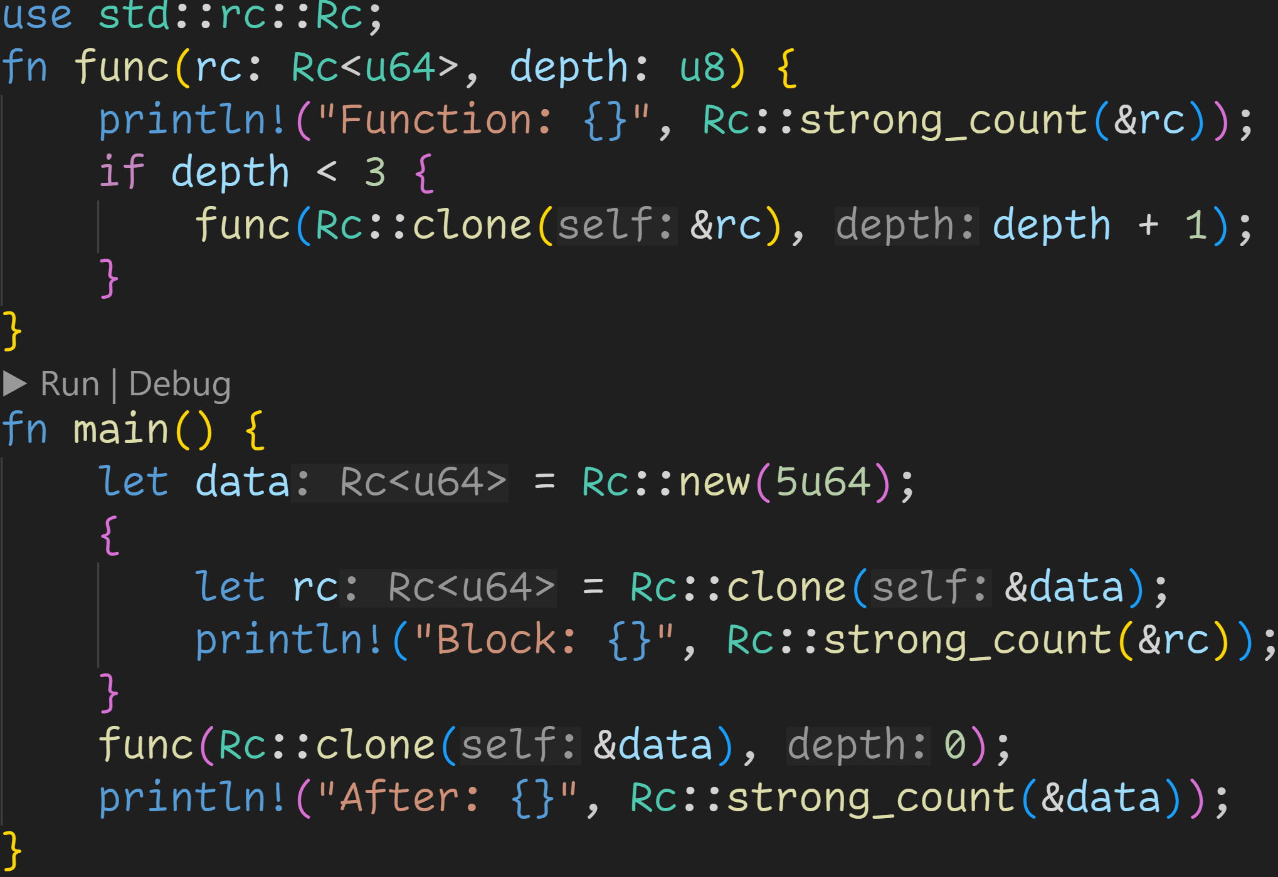

Slide 12
Create Rc<T>

Slide 13
Share data at many points in our code

Slide 14
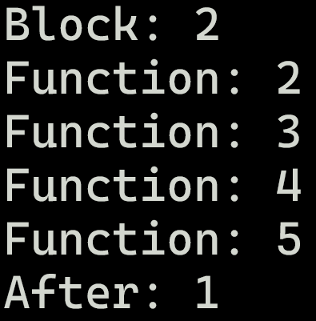
Recap

Slide 15
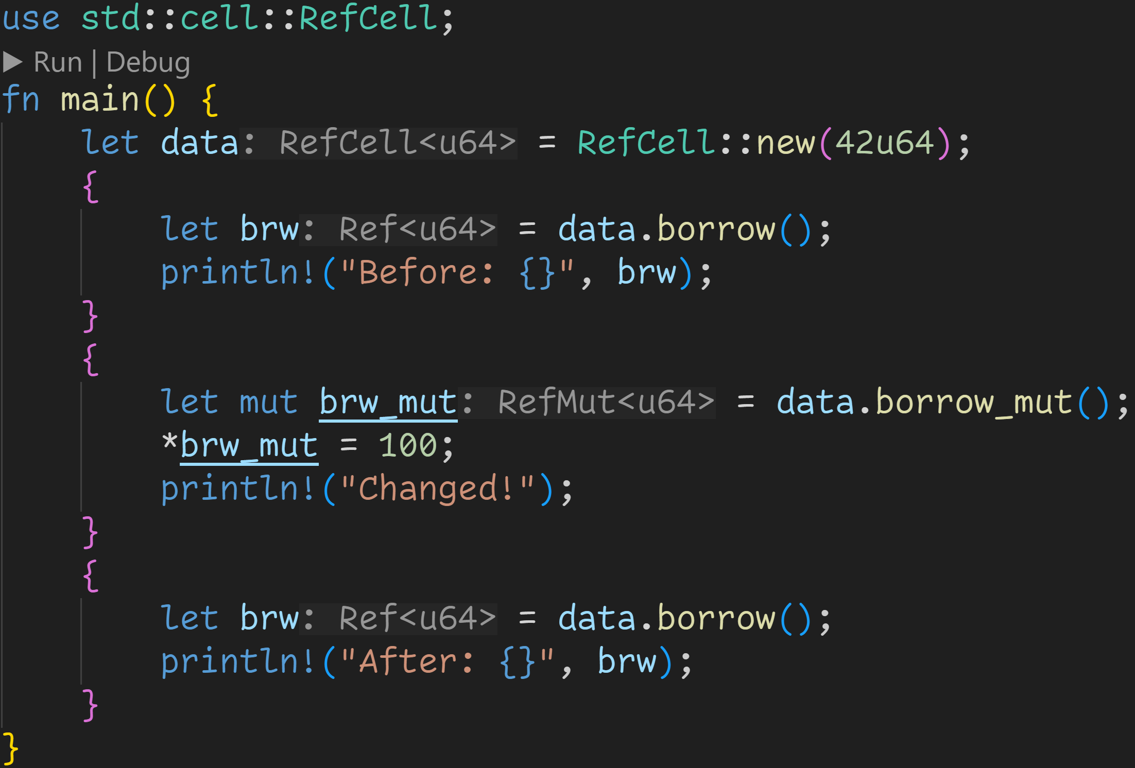

Slide 16
Create RefCell<T>

Slide 17
Borrows are valid until the value is dropped
→ No violations here, everything is good

Slide 18
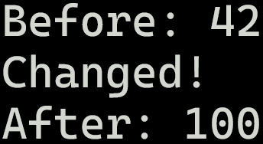
Recap

Slide 19
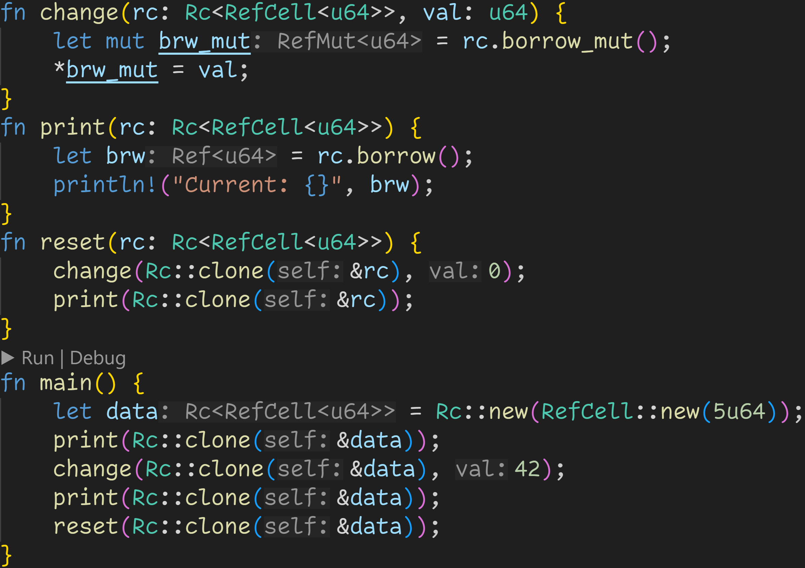
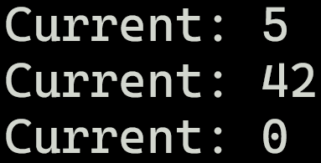

Slide 20
Use wherever we want

Slide 21
Change wherever we want

Slide 22
Weak<T>

Slide 23
Weak<T>
Rc<T> can easily cause reference cycles, which means we never drop values → Memory leaks

Slide 24
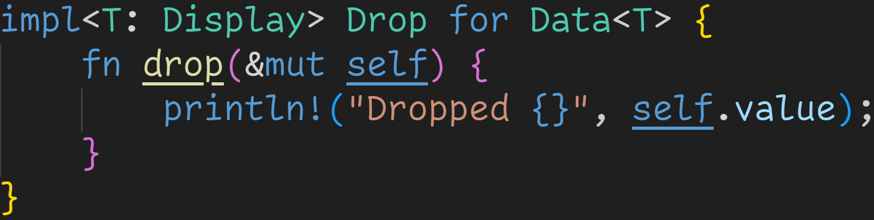
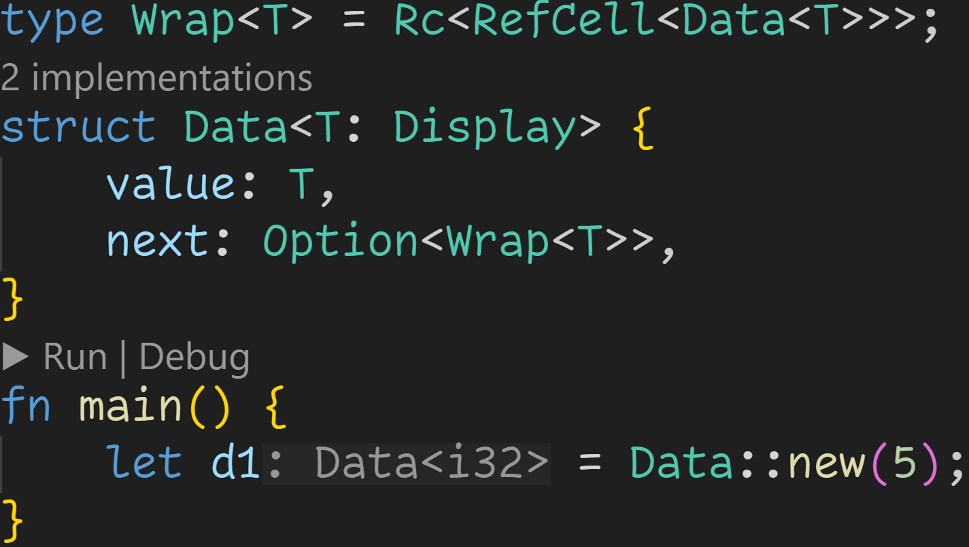
Weak<T>

Slide 25
Weak<T>
d1
value | 5
next | None

Slide 26
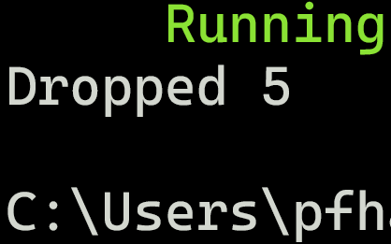
Weak<T>
d1
value | 5
next | None

Slide 27
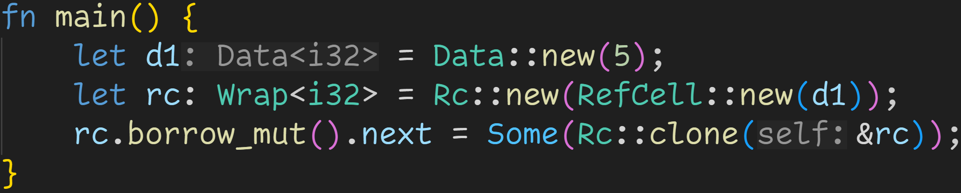
Weak<T>

Slide 28
Weak<T>
d1
value | 5
next | None

Slide 29
Weak<T>
d1
value | 5
next | None
rc
data | d1
count | 1

Slide 30
Weak<T>
d1
value | 5
next | rc
rc
data | d1
count | 2

Slide 31
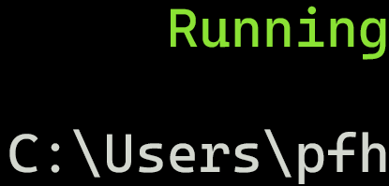
Weak<T>
d1
value | 5
next | rc
rc
data | d1
count | 2

Slide 32
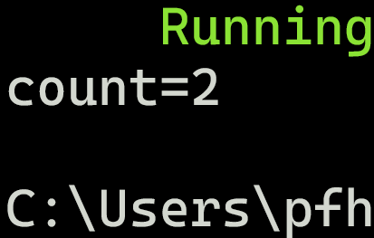
Weak<T>
d1
value | 5
next | rc
rc
data | d1
count | 2

Slide 33
Weak<T>
Rc<T> can easily cause reference cycles, which means we never drop values → Memory leaks
For that reason, Rc<T> has a downgraded version of itself: Weak<T>

Slide 34
Weak<T>
Rc<T> can easily cause reference cycles, which means we never drop values → Memory leaks
For that reason, Rc<T> has a downgraded version of itself: Weak<T>
In reality, Rc<T> keeps track of two reference counts
strong_count → How many Rc<T> are there?
weak_count → How many Weak<T> are there?

Slide 35
Weak<T>
Rc<T> can easily cause reference cycles, which means we never drop values → Memory leaks
For that reason, Rc<T> has a downgraded version of itself: Weak<T>
In reality, Rc<T> keeps track of two reference counts
strong_count → How many Rc<T> are there?
weak_count → How many Weak<T> are there?
Rc<T> drops the value once the strong_count is 0, weak_count doesn‘t matter

Slide 36
Weak<T>
Rc<T> can easily cause reference cycles, which means we never drop values → Memory leaks
For that reason, Rc<T> has a downgraded version of itself: Weak<T>
In reality, Rc<T> keeps track of two reference counts
strong_count → How many Rc<T> are there?
weak_count → How many Weak<T> are there?
Rc<T> drops the value once the strong_count is 0, weak_count doesn‘t matter
Weak means not-binding, we can have Weak<T> references to dropped values
Because of that, we can‘t just access the data of Weak<T>
But we can try and upgrade Weak<T> to Rc<T> at any time

Slide 37
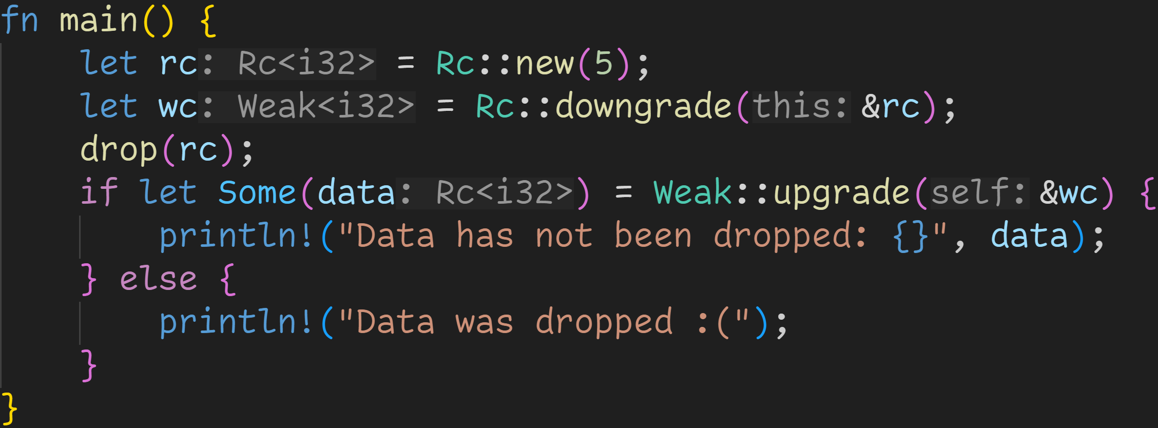
Weak<T>

Slide 38
Weak<T>
Turn Rc<T> into Weak<T>

Slide 39
Weak<T>
Try to upgrade → Fails if underlying data was dropped → Returns Option<Rc<T>>

Slide 40
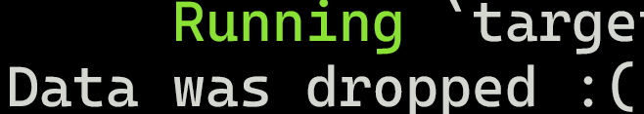
Weak<T>
strong_count decreased to 0 here → Underlying data dropped

Slide 41
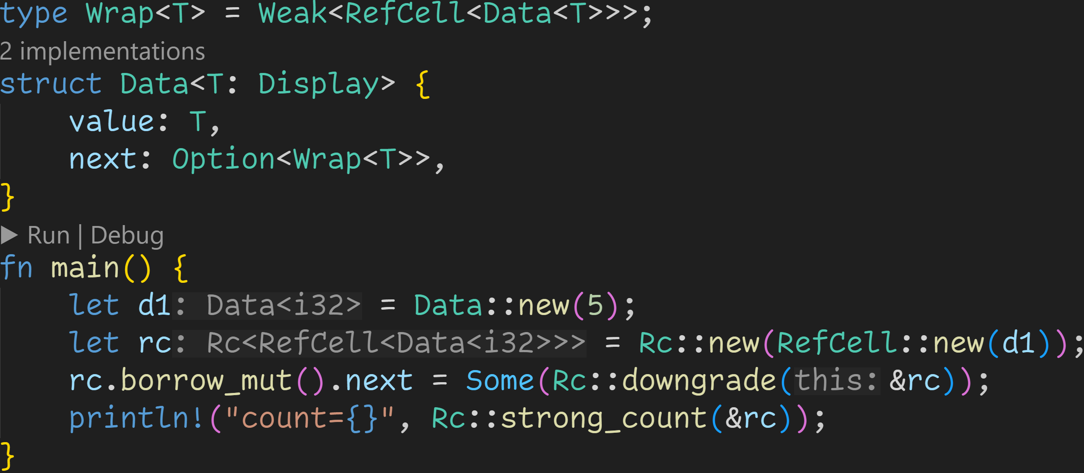
Weak<T>

Slide 42
Weak<T>
Small modifications, breaking strong reference cycles

Slide 43
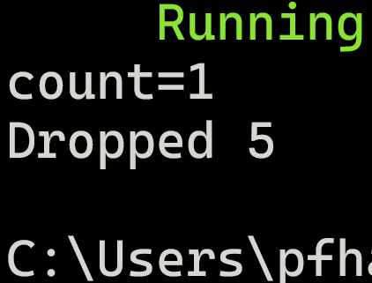
Weak<T>

Slide 44
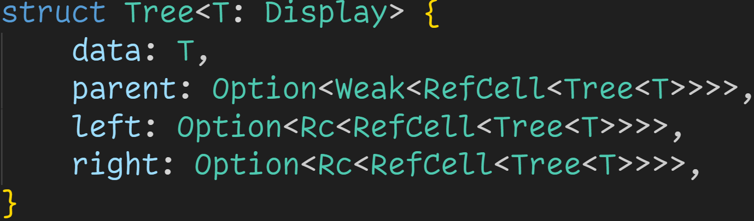
Weak<T>

Slide 45
Weak<T>
Idea: → As long as the node lives, the children (left and right) should also exist
→ For some cases we would also like to access the parent (e.g. for traversal)
→ If managed properly, parent will always point to an undropped node

Slide 46
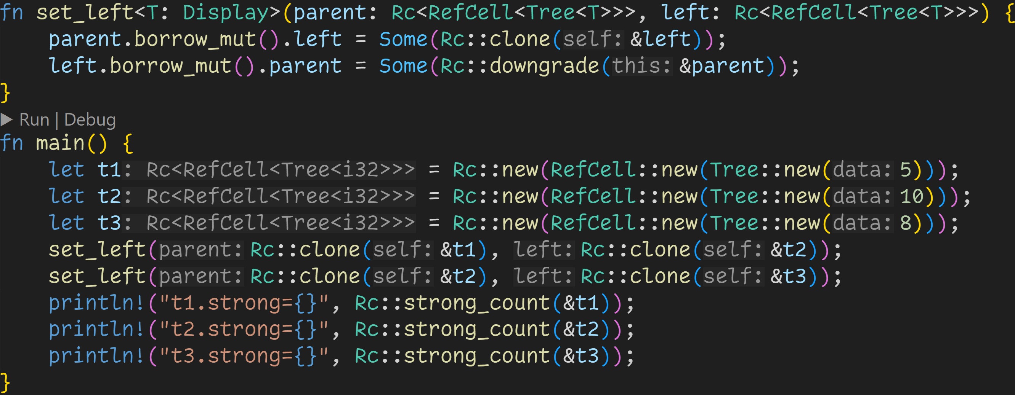
Weak<T>

Slide 47
Weak<T>
Management of references: Child node (left) should also know who the parent is

Slide 48
Weak<T>
Create some nodes

Slide 49
Weak<T>
Set children

Slide 50
Weak<T>
Heap
t1 | data | 5
 | strong | 1
 | weak | 1
t2 | data | 10
 | strong | 2
 | weak | 1
t3 | data | 8
 | strong | 2
 | weak | 0
t1
t2
t3

Slide 51
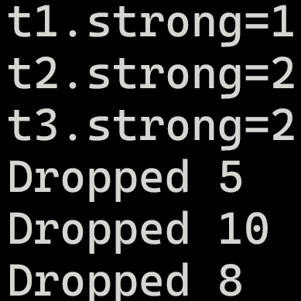
Weak<T>
Heap
t1 | data | 5
 | strong | 1
 | weak | 1
t2 | data | 10
 | strong | 2
 | weak | 1
t3 | data | 8
 | strong | 2
 | weak | 0
t1
t2
t3

Slide 52
Declarative Macros

Slide 53
Declarative Macros
Macros are a syntax extension of the language, and serve many purposes

Slide 54
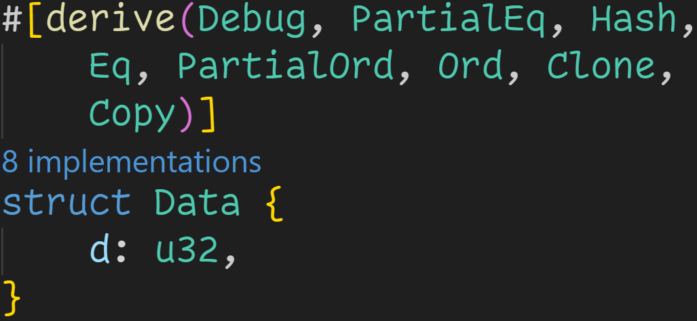
Declarative Macros
Macros are a syntax extension of the language, and serve many purposes
Generate boilerplate code (Derive-like macros)

Slide 55
Declarative Macros
Macros are a syntax extension of the language, and serve many purposes
Generate boilerplate code (Derive-like macros)
Emits
impl <Trait> for Data {
/* functions */
}
for every of those traits

Slide 56
Declarative Macros
Macros are a syntax extension of the language, and serve many purposes
Generate boilerplate code (Derive-like macros)
Specify attributes for the compiler, like special warnings and optimizations

Slide 57
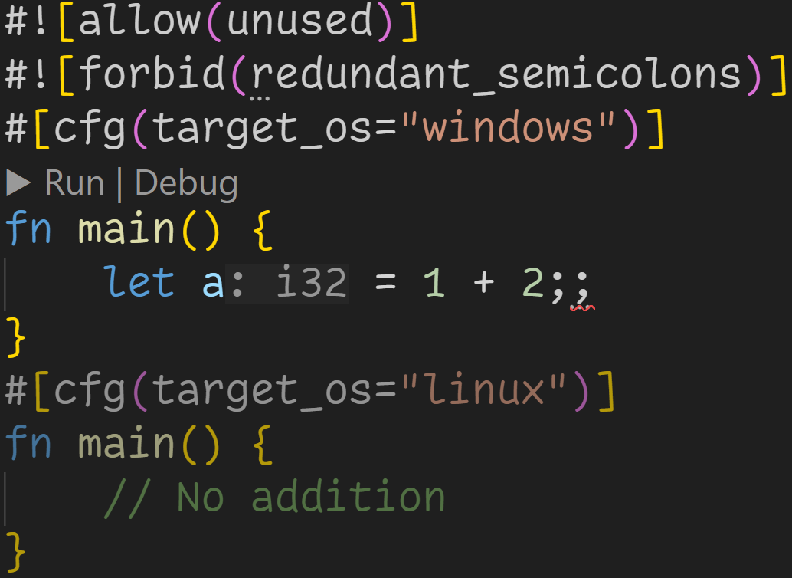
Declarative Macros

Slide 58
Declarative Macros
Attributes for the linter:
→ Dont warn that a is unused
→ Throw an error for that semicolon

Slide 59
Declarative Macros
Attributes for the linter:
→ Dont warn that a is unused
→ Throw an error for that semicolon
Conditionally compile code
→ Here we define different entrypoints based on if we‘re on Windows or Linux

Slide 60
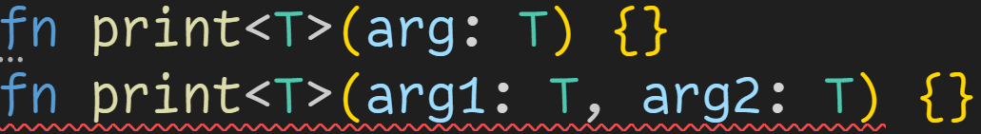
Declarative Macros
Macros are a syntax extension of the language, and serve many purposes
Generate boilerplate code (Derive-like macros)
Specify attributes for the compiler, like special warnings and optimizations
Defining functions that take a variadic amount of arguments

Slide 61
Declarative Macros
Macros are a syntax extension of the language, and serve many purposes
Generate boilerplate code (Derive-like macros)
Specify attributes for the compiler, like special warnings and optimizations
Defining functions that take a variadic amount of arguments
To understand how macros work, we first need to take a small crash course of compilers

Slide 62
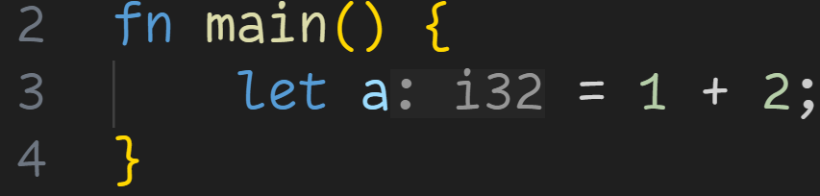
Declarative Macros

Slide 63
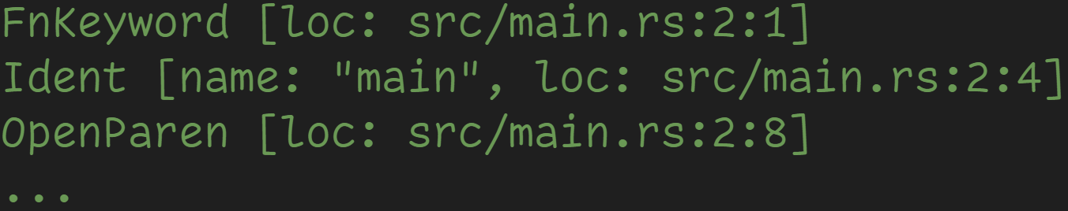
Declarative Macros

Slide 64
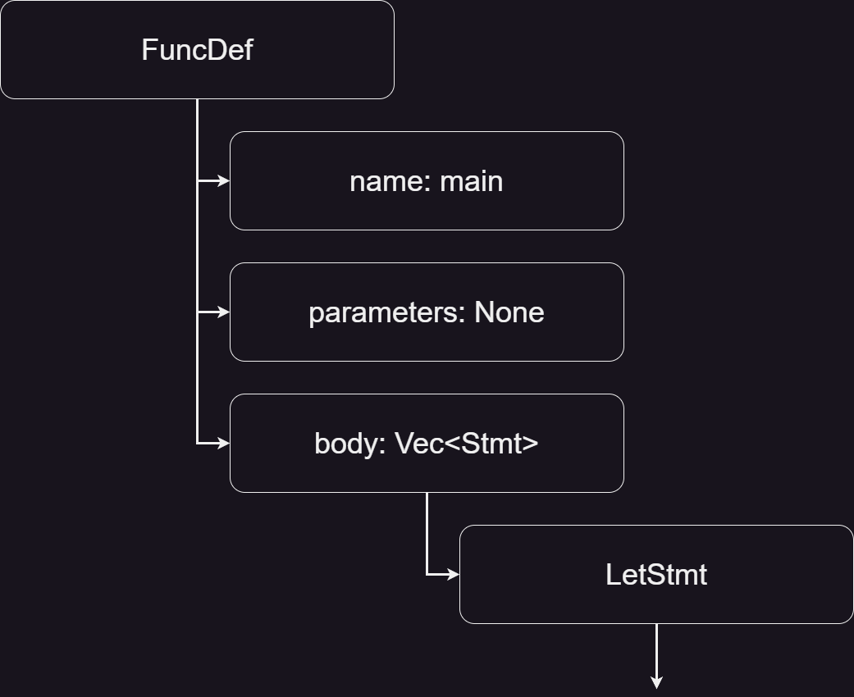
Declarative Macros

Slide 65
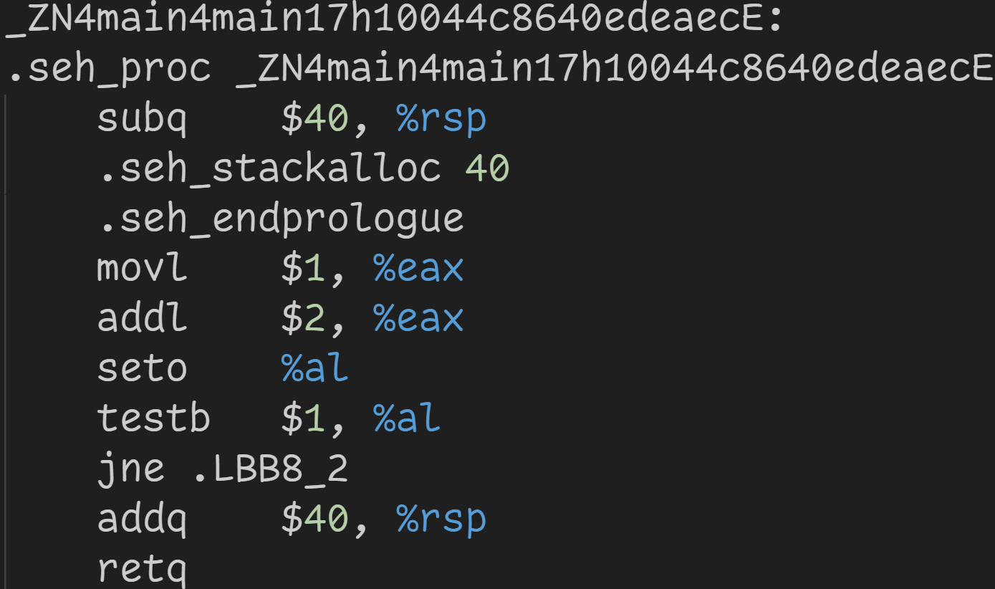
Declarative Macros

Slide 66
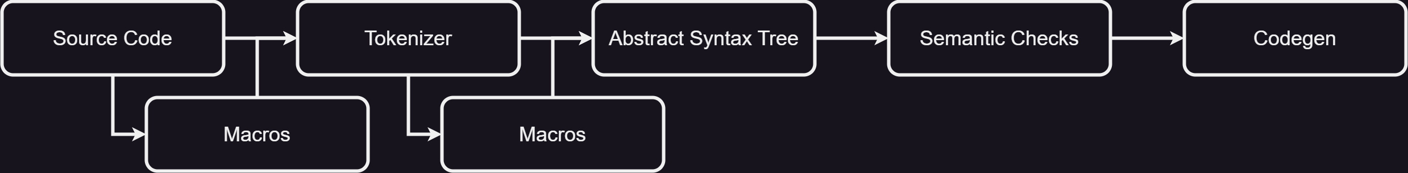
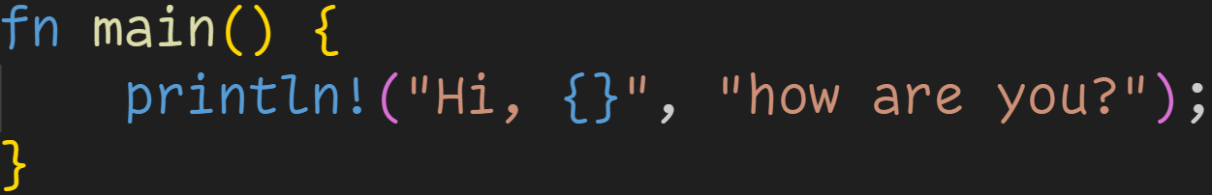
Declarative Macros

Slide 67
Declarative Macros
println! gets expanded into a sequence of tokens and ultimately an AST node

Slide 68
Declarative Macros
Declarative macros are their own sub-language, with their own rules and syntax
Procedural macros are plain Rust, but they‘ll be covered later

Slide 69
Declarative Macros
Declarative macros are their own sub-language, with their own rules and syntax
Declarative macros are declared using the keyword macro_rules

Slide 70
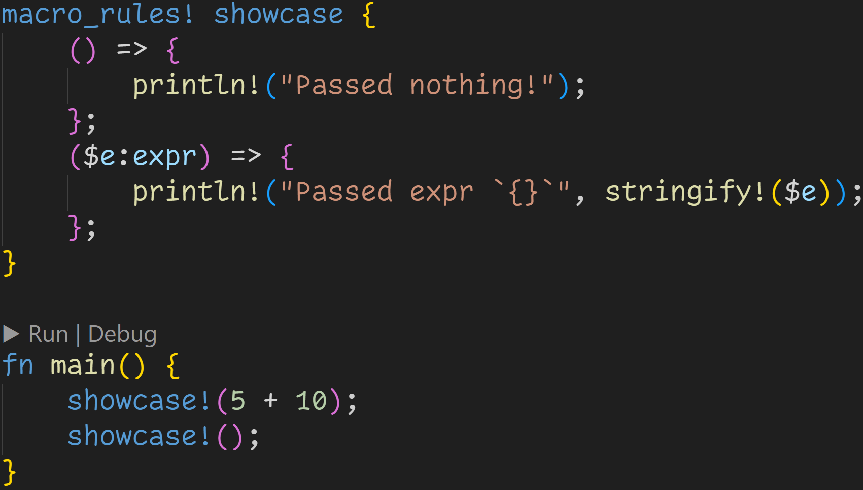
Declarative Macros

Slide 71
Declarative Macros
Name of the macro

Slide 72
Declarative Macros
A sequence of cases to match against → When you invoke the macro, cases are checked from top to bottom and the first match is chosen

Slide 73
Declarative Macros

Slide 74
Declarative Macros
If the case matches, we insert the code in the block after

Slide 75
Declarative Macros
Matched nodes are assigned to special identifiers (marked with $) so we can use them in the macro → Example expands to stringify!(5 + 10)

Slide 76
Declarative Macros
Macros allow recursion, those are also expanded

Slide 77
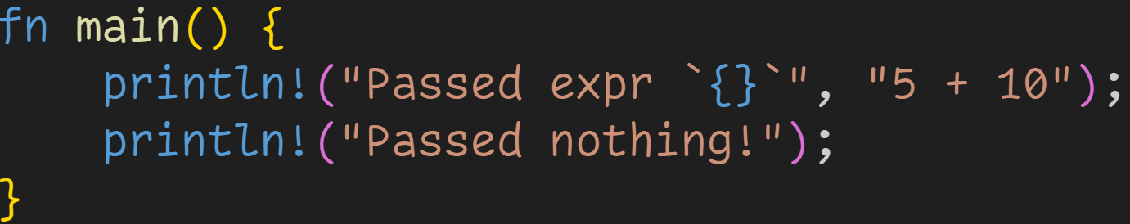
Declarative Macros
Our macro would expand to this (ignoring println!)
→ cargo install cargo-expand to see what the raw code looks like
→ Adds cargo expand to the list of possible subcommands

Slide 78
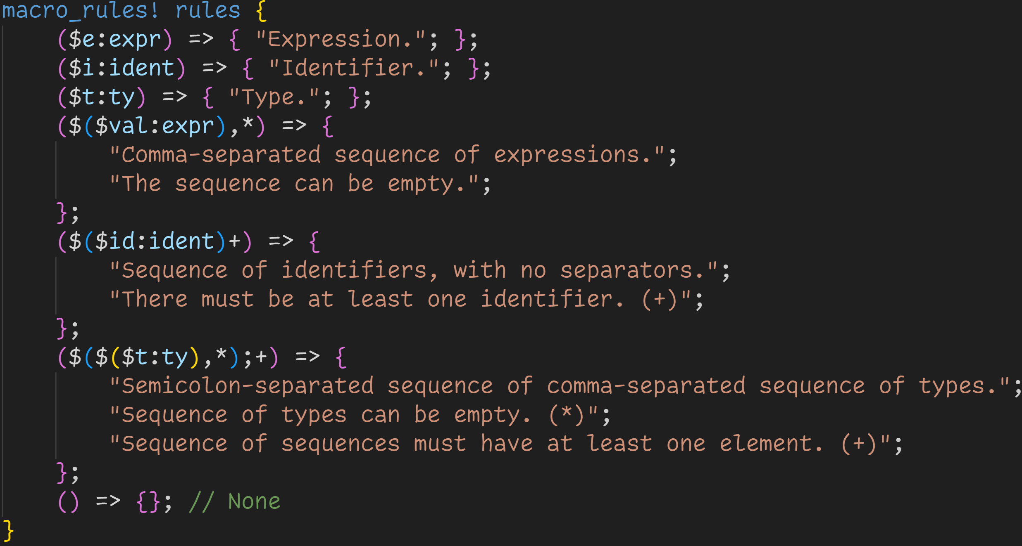
You can match against many different cases in different complexities

Slide 79
You can match against variadic amounts of arguments

Slide 80
rules!(5 + 10, „Hello“) would match this case and bind both 5 + 10 and „Hello“ to $val

Slide 81
rules!(i32, u8; &str, String) would match this case

Slide 82
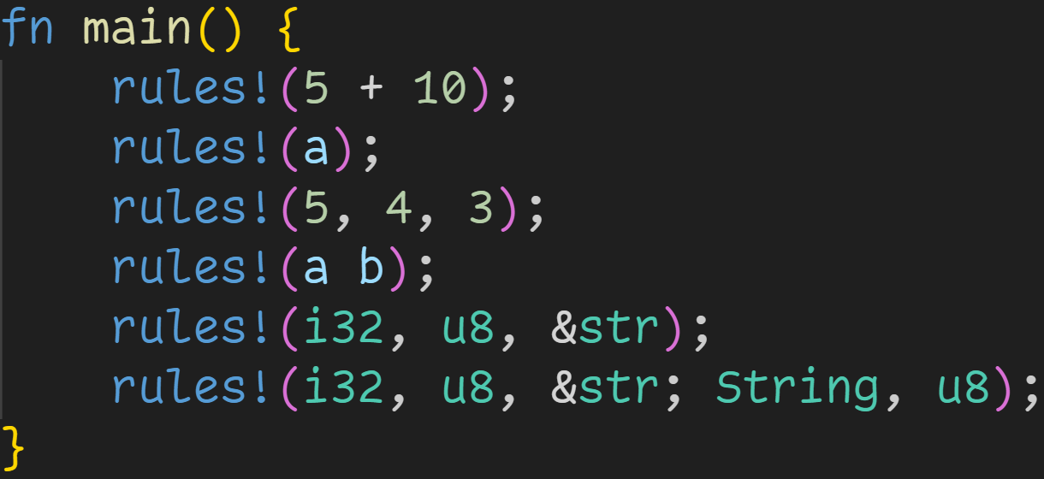
Declarative Macros

Slide 83
Declarative Macros
3/3
Which cases match?

Slide 84
Declarative Macros
3/3
Which cases match?

Slide 85
Declarative Macros
a is also a valid expression
→ Cases are evaluated top to bottom
3/3
Which cases match?

Slide 86
Declarative Macros
3/3
Which cases match?

Slide 87
Declarative Macros
3/3
Which cases match?

Slide 88
Declarative Macros
→ Missing ; for the last rule → Technically valid identifiers → valid expressions
3/3
Which cases match?

Slide 89
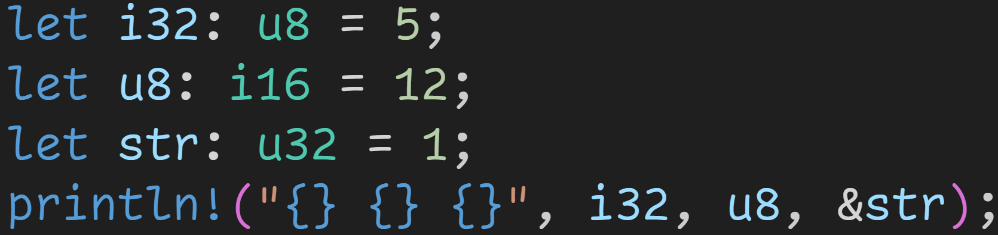
Declarative Macros
→ Missing ; for the last rule → Technically valid identifiers → valid expressions
3/3
Which cases match?

Slide 90
Declarative Macros
3/3
Which cases match?

Slide 91
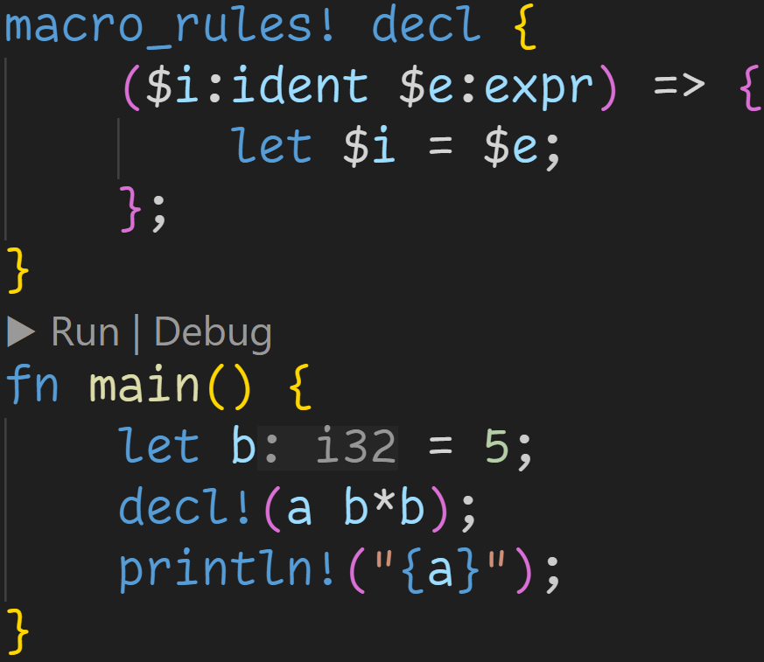
Declarative Macros
Using macros we can now write simple code generators

Slide 92
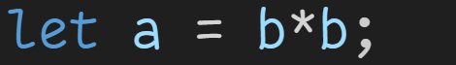
Declarative Macros
Macro call expands to this code
We can now use a here

Slide 93
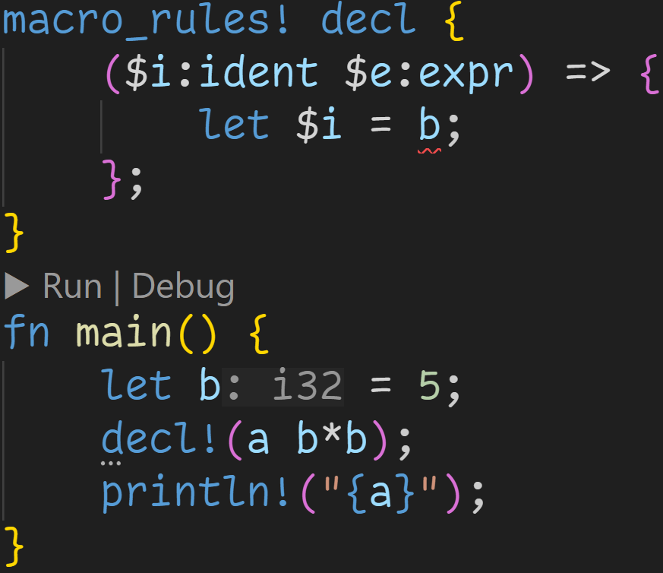
Declarative Macros
However, macros are partially hygienic: → They are doing more than just inserting code → We can not use b because the scopes differ

Slide 94
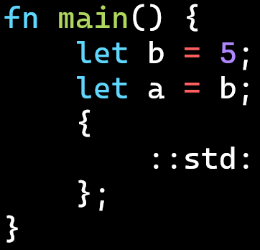
Declarative Macros
However, macros are partially hygienic: → They are doing more than just inserting code → We can not use b because the scopes differ Even though the generated code is perfectly fine!

Slide 95
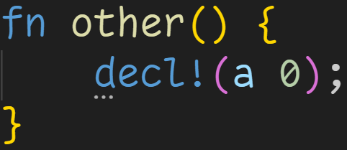
Declarative Macros
However, macros are partially hygienic: → They are doing more than just inserting code → We can not use b because the scopes differ Even though the generated code is perfectly fine! → Imagine using decl!() where there is no b

Slide 96
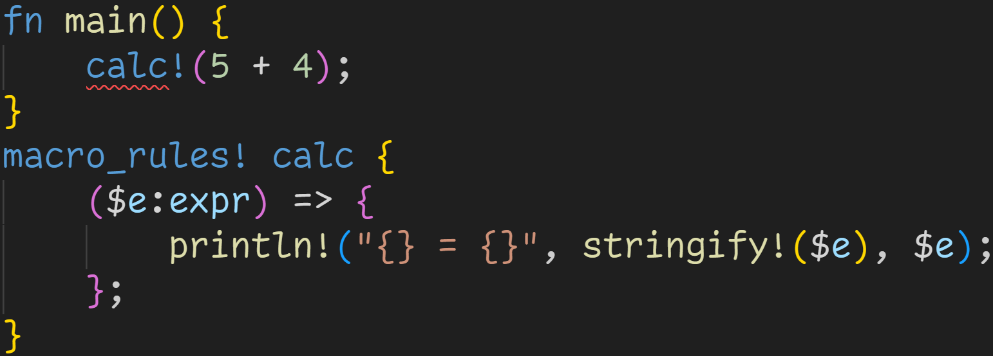
Declarative Macros
Macros must be defined before they are used

Slide 97
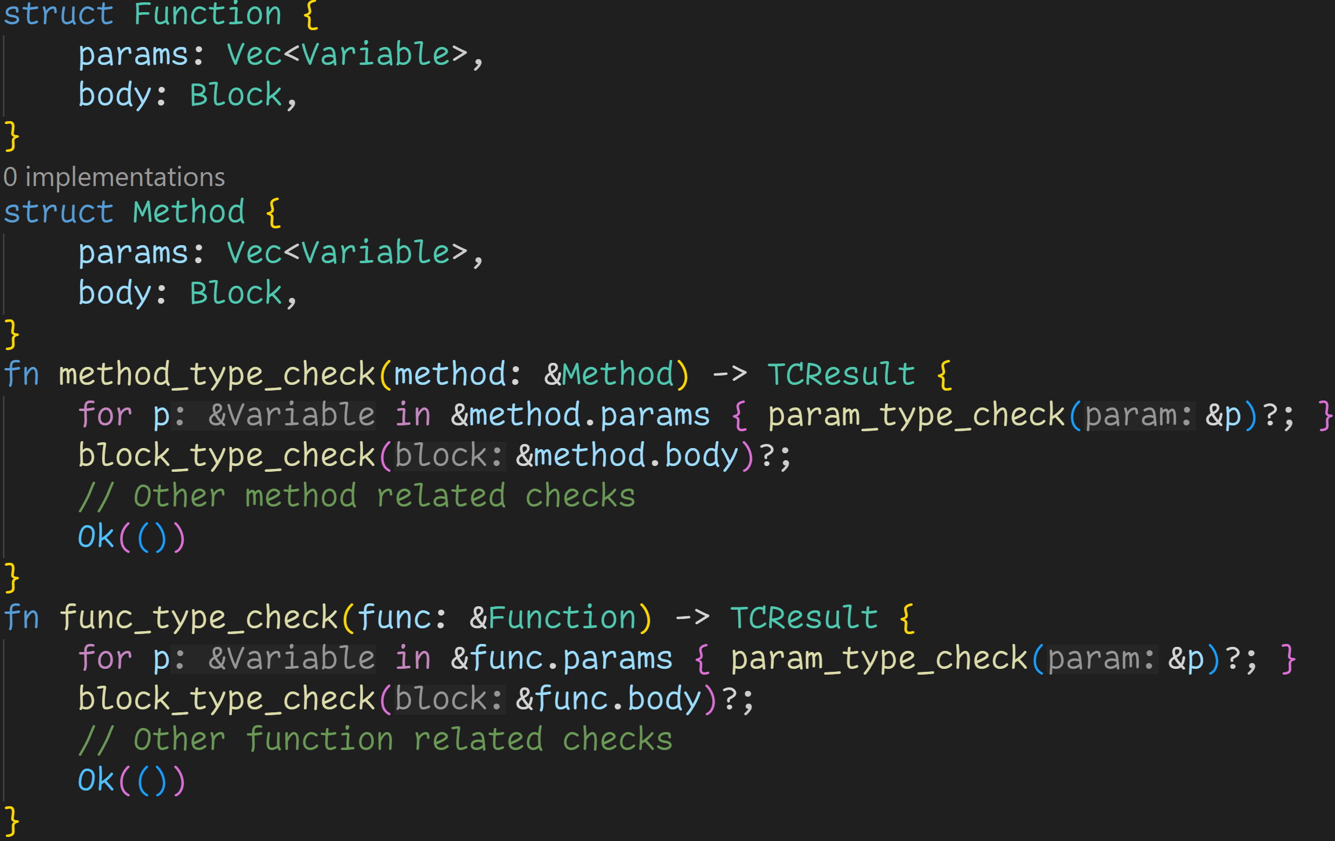

Slide 98
Duplicated code that can not be factored out into a single function → How can a function take both a Method and a Function? → No function overload in Rust

Slide 99
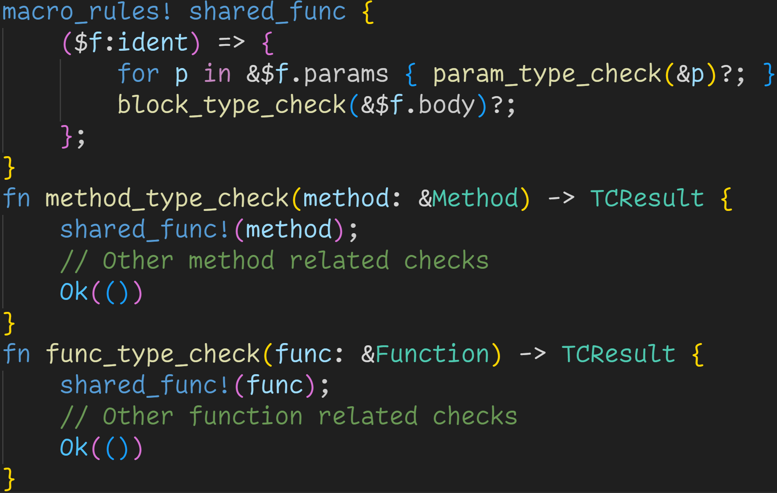

Slide 100
Shared behavior can be factored into a macro, which does not care about any types → Further checks will then decide if method.params and func.params is a valid thing

Slide 101
However, this macro is not hygienic either, and needs refinement (even if it works just fine)
3/3
What could cause problems?

Slide 102
Early exit
Early exit
3/3
What could cause problems?
It‘s not clear to the user that this macro could exit the function
→ It modifies control flow without being visible

Slide 103
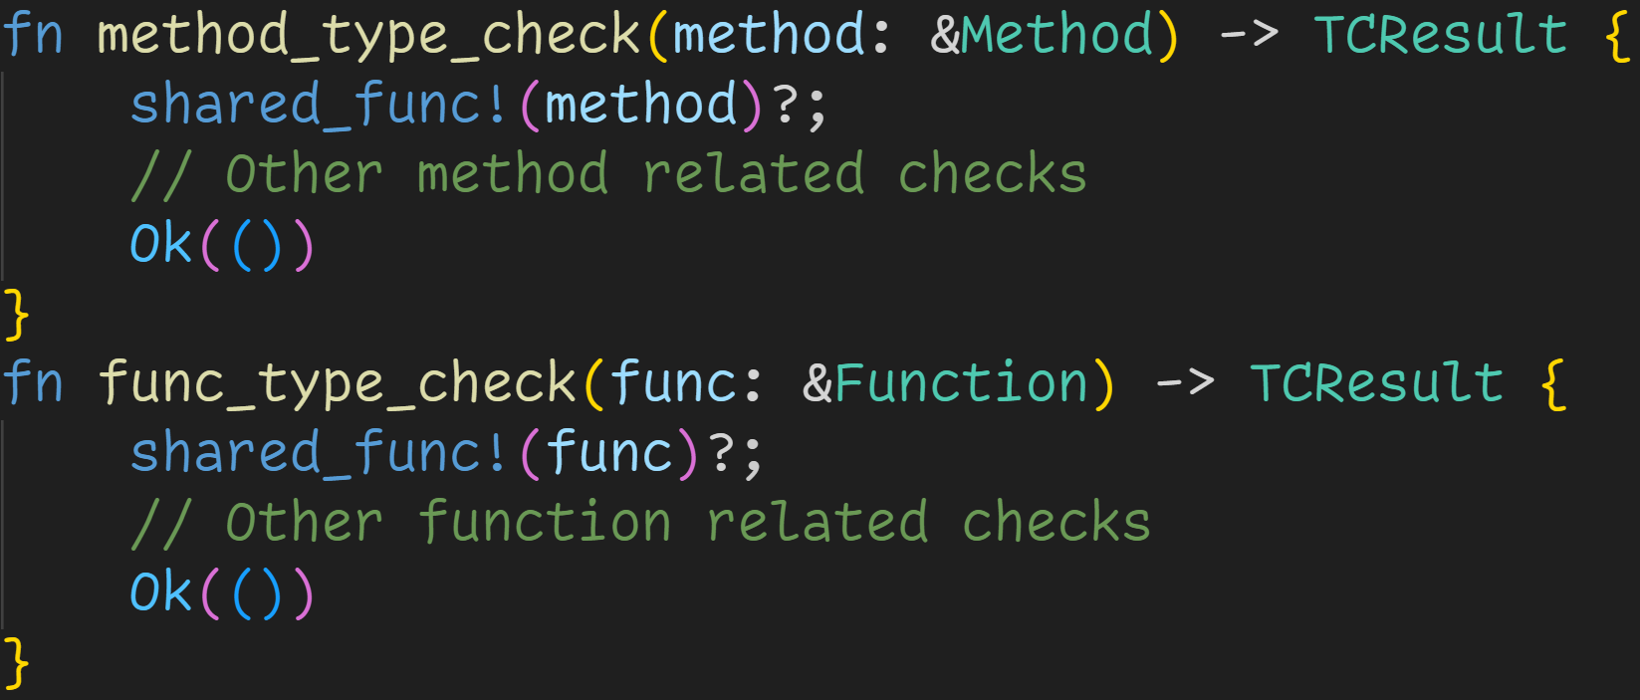
It would be nicer if we could denote this behavior here

Slide 104
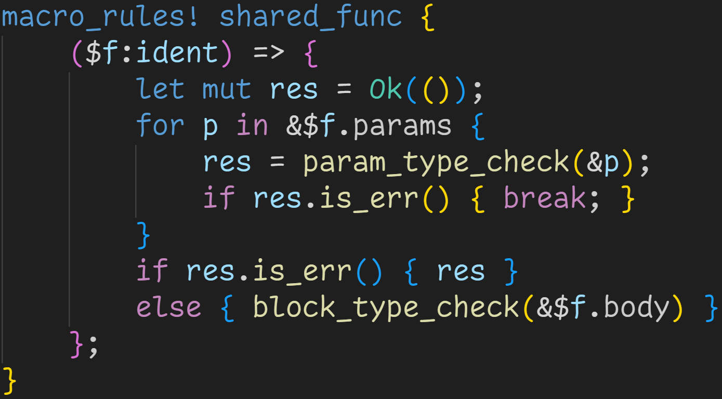
Idea: Instead of returning early, we just skip everything once we fail

Slide 105
Idea: Instead of returning early, we just skip everything once we fail
Last statement is an expression, so it should return like a normal function?

Slide 106
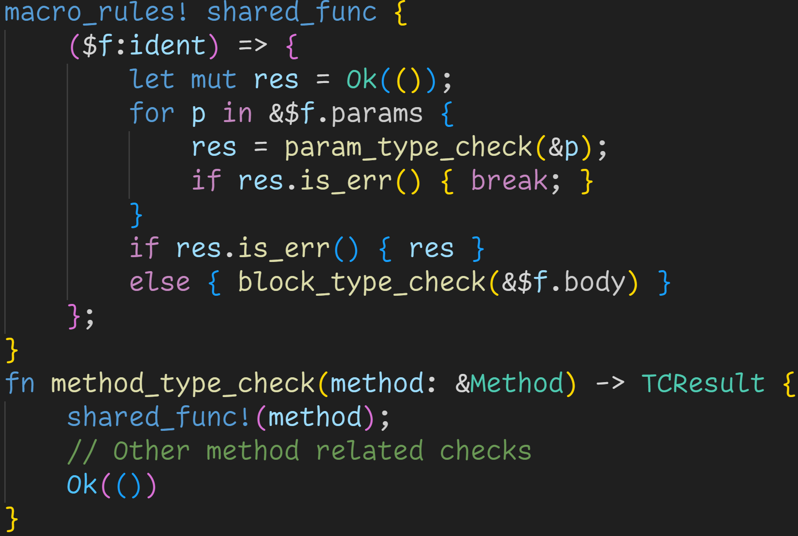

Slide 107
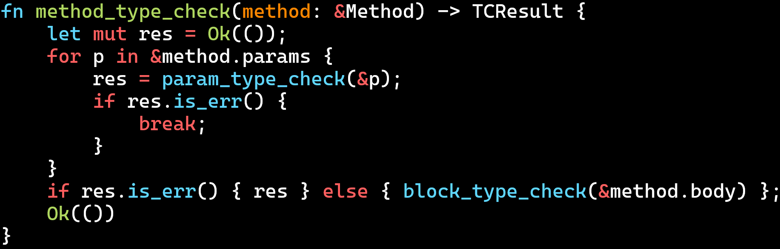

Slide 108
Missing the ?

Slide 109
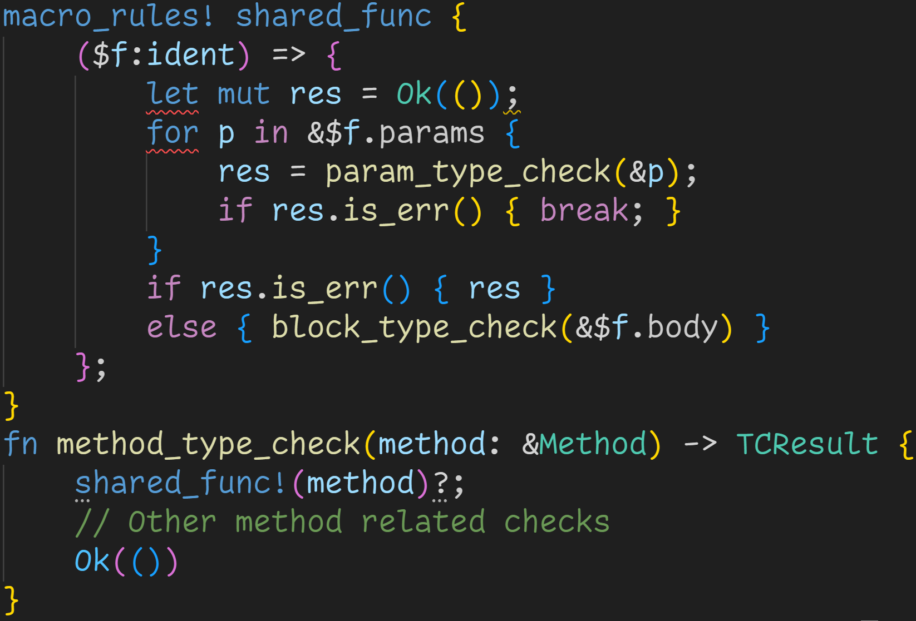

Slide 110
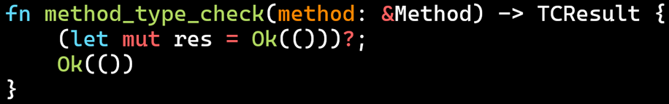

Slide 111
→ Macro parsing and expansion is built into the parser at specific locations (part of the grammar)

Slide 112
→ Macro parsing and expansion is built into the parser at specific locations (part of the grammar) → Depending on context macros are evaluated differently

Slide 113
→ Macro parsing and expansion is built into the parser at specific locations (part of the grammar) → Depending on context macros are evaluated differently → The ? turns the macro call from a statement into an expression → Macros don‘t insert code, they expand to AST nodes

Slide 114
→ The ? turns the macro call from a statement into an expression Which is actually what we want, except that we want the whole macro to be the expression

Slide 115
→ The ? turns the macro call from a statement into an expression Which is actually what we want, except that we want the whole macro to be the expression → We need to tell Rust that those statements form a single expression

Slide 116
→ The ? turns the macro call from a statement into an expression Which is actually what we want, except that we want the whole macro to be the expression → We need to tell Rust that those statements form a single expression → Single expressions of that form are blocks → We need to add curly brackets

Slide 117
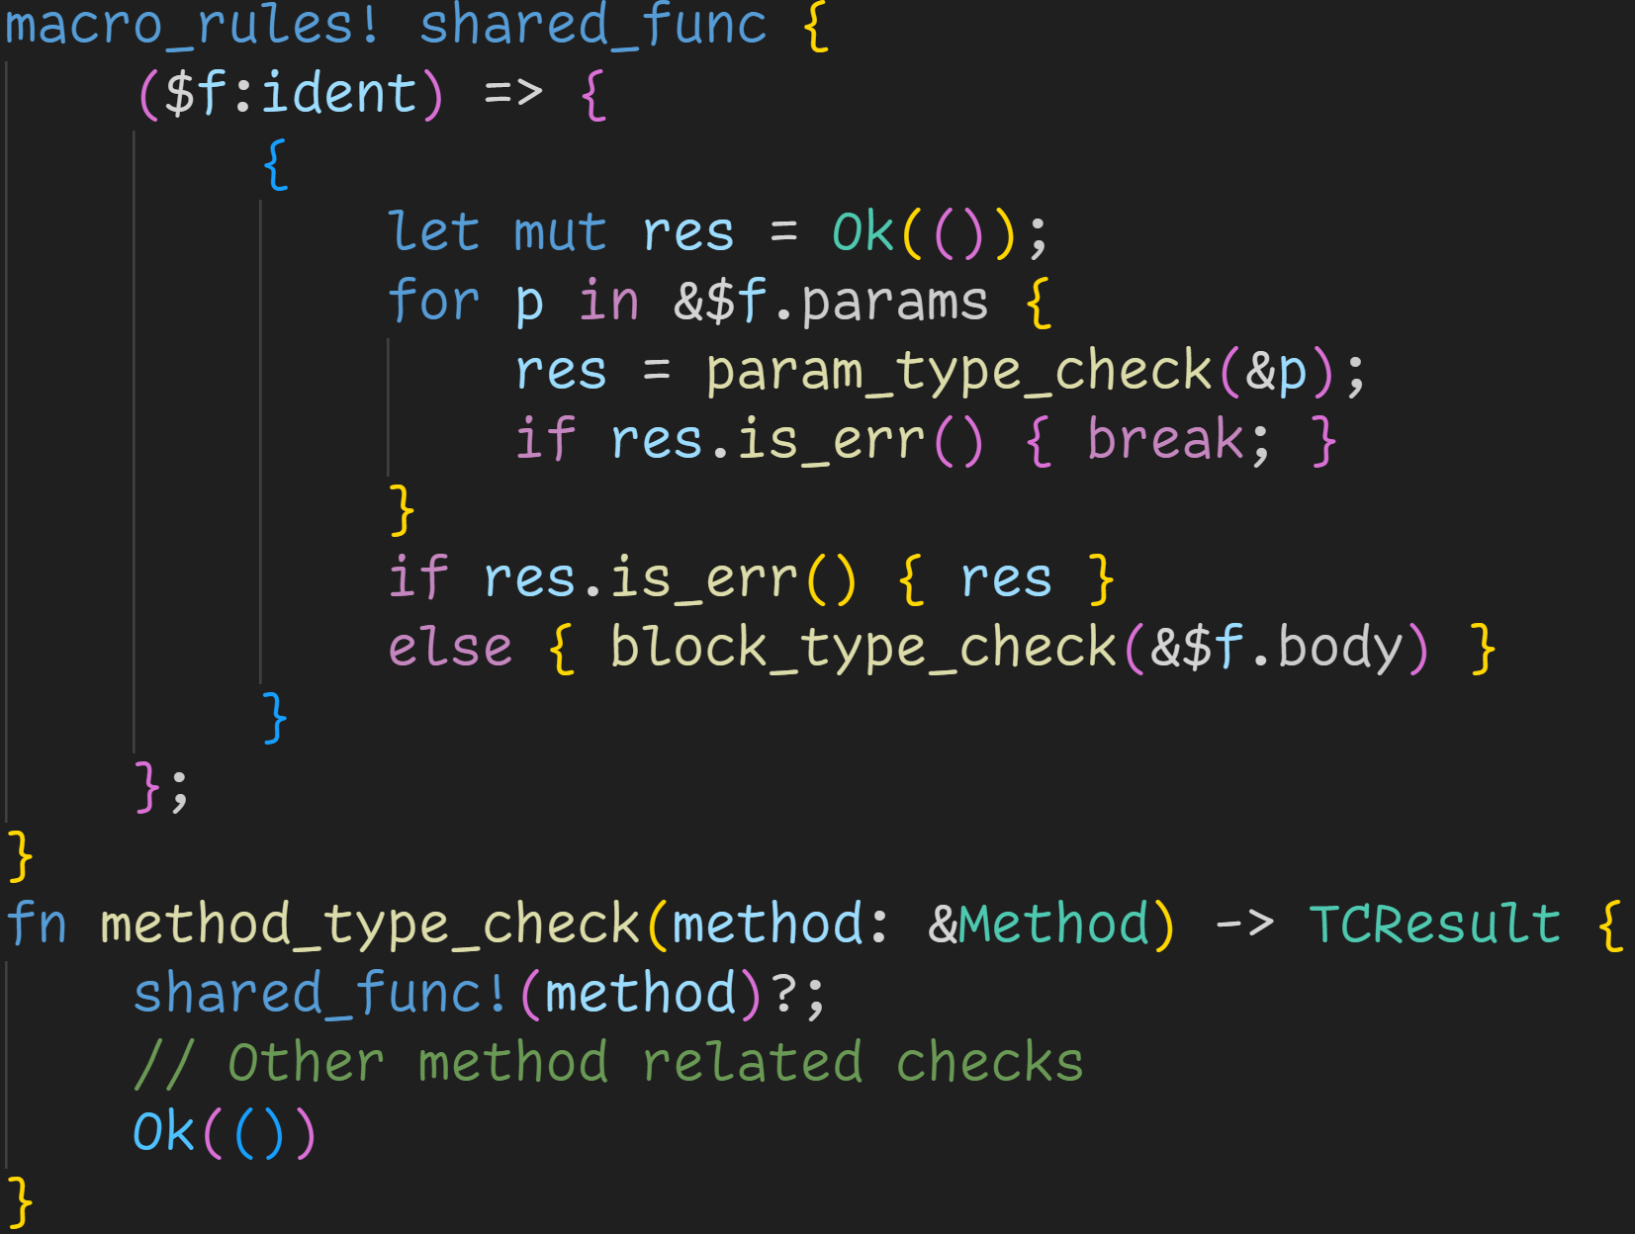

Slide 118
Macro expands into a single block

Slide 119
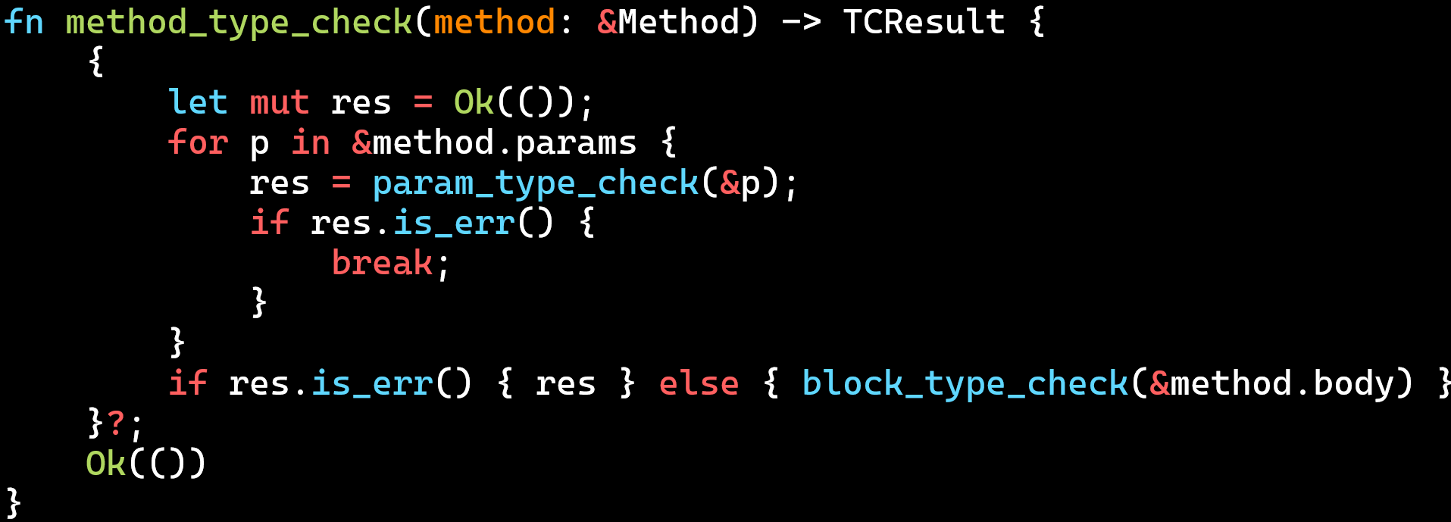
Macro expands into a single block

Slide 120
Next time
tt-munchers
Procedural Macros

